Slide 1
LECTURE 11 SLIDES
Strategic Firm Behavior
Part A: Price Discrimination
Part B: Predatory Pricing
Part C: Two-Part Tariffs
Part D: Application - Utility Industries
Part E: Non-Price Strategies
© Anna P. Della Valle

Slide 2


Overview of Topic
Government intervention
Regulation of entry, prices, investment, quality
Antitrust
Patents, copyright, trademarks
Market structure:
Perfect competition
Monopolistic competition
Noncooperative oligopoly
Cooperative Oligopoly
Monopoly
FirmStrategy:
Pricing strategies:
Price taker
Price maker
Price discrimination
Predatory pricing
Two-part tariffs
Non-price strategies:
Product differentiation
Marketing/advert/branding
Vertical integration
Entry-deterrent strategies
Tie-Ins
Lobbying
Research & development
Mergers and acquisitions

Slide 3

Part A: Price Discrimination
Charging different prices to different consumers

Slide 4



Examples of Price Discrimination
Price discrimination can be based on:
Age (discounts to senior citizens)
Sex (free drinks to women during happy hour)
Health (higher insurance premiums for smokers

Slide 5
Other forms of Price Discrimination
Lower prices for informed customers
Promotional discounts (for first time buyers)
Cash and Carry
Quantity discounts
Quality discrimination

Slide 6
Competitive Market No Price Discrimination
Market clears at a single price which is the
same for all buyers
Price
Supply
Consumer
Surplus
P*
Demand
0
Q*
Quantity

Slide 7
Monopoly Market No Price Discrimination
Monopolist charges same profit max price to all buyers
Price
CS
Marginal cost
P Monopoly
Demand
Marginal revenue
0
Q monopoly
Quantity

Slide 8
Why Price Discriminate?
Increase revenue/profit by
transferring some of the consumer surplus
from consumers to producers

Slide 9
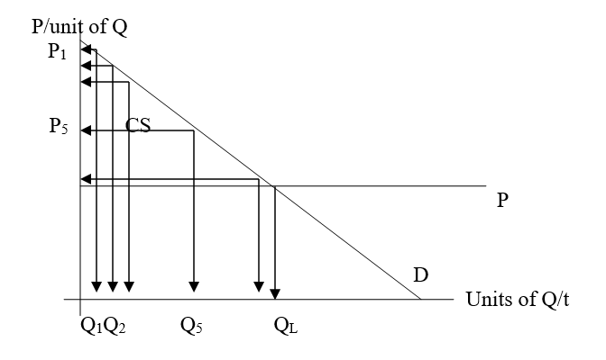
Perfect Price Discrimination:
Charge different prices based on willingness to pay

Slide 10
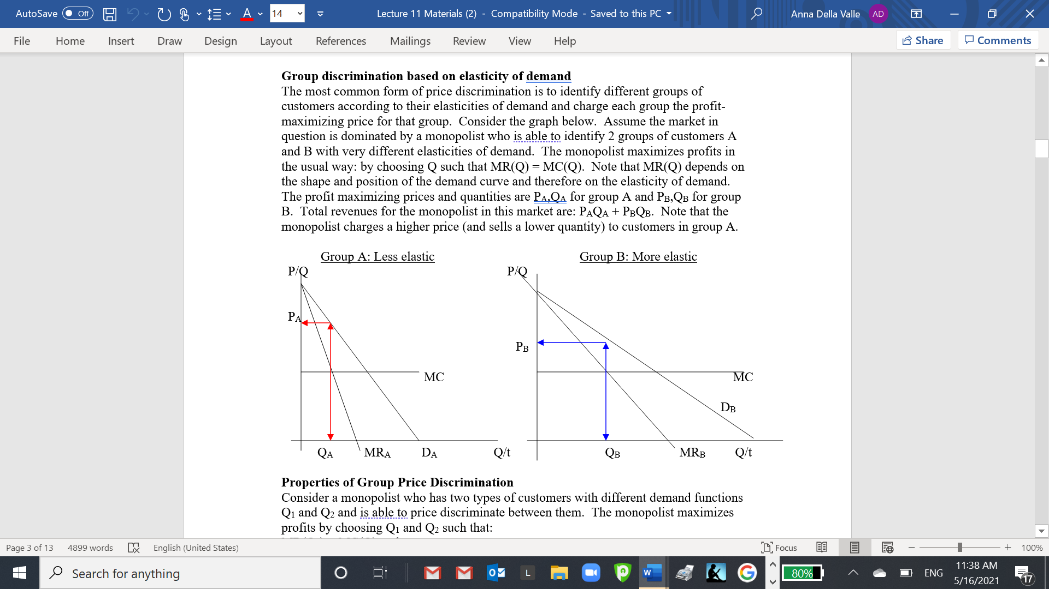
Group Price Discrimination
Charge different prices based on group’s demand/elasticity

Slide 11
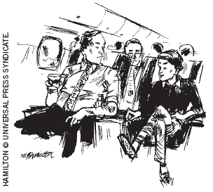
Example of Price Discrimination based on elasticity: Business Travel
“Would it bother you to hear how little I paid for this flight?”

Slide 12


Example of price discrimination based on elasticity:
Movie theatre matinees
Also, popcorn sold
in movie theatres!

Slide 13
Group Price Discrimination to Maximize Profits
Maximize profits by choosing Q1 and Q2 such that:
MR(Q1) = MC(Q) and
MR(Q2) = MC(Q)
Note: MC(Q) is the same for both groups of customers

Slide 14
Properties of Group Price Discrimination
Equality of marginal revenues across groups at profit max quantities:
MR(Q1) = MR(Q2) = MR(Q3)….
Marginal revenue at profit max quantity for each group = MC(Q):
MR(Qi) = MC(Q) i = 1,2,3…
Profit maximizing Lerner Index property holds for each group:
(Pi – MC)/Pi = -1/Ei i = 1,2,3...

Slide 15
Conditions necessary to price discriminate
Seller must be able to estimate different group’s demand/elasticities
Seller must have some degree of market power (the more the better)
No resale!

Slide 16


Conditions that make resale difficult
Goods of a personal nature
Contractual constraints prohibiting resale
Void warranties if good is resold
High transactions costs associated with resale (transportation, bureaucracy)

Slide 17


Conditions that make resale difficult (cont.)
Personalize product with logo

Slide 18

Part B: Predatory Pricing

Slide 19


Intention of Predation
Predatory pricing occurs when a firm sets price below cost
with the intention of driving out competitors
or would be entrants
Dumping
http://www.lawyr.it/index.php?option=com_content&view=article&id=865:anti-dumping-measures&catid=101&Itemid=724

Slide 20

Antitrust Standards for Predation
Predatory pricing (or dumping) is illegal under antitrust laws of many developed countries
P < AVC or < MC for extended time is predatory
P < ATC but > AVC OK
Promotional sales OK
Sales to reduce inventory OK
Pricing below cost for start ups and to establish brand OK (Amazon and other tech company business models)

Slide 21
Part C: Two-Part Tariffs
Price has 2 components:
Usage fee tied to quantity consumed
Fixed fee unrelated to usage

Slide 22
Two-Part Tariff to Capture Consumer Surplus
Price
Fixed charge
MC
Usage fee
Pu
Demand
0
Qu
Quantity

Slide 23
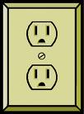


Part D:
Application of Two- Part Tariffs
Utlility Industries

Slide 24
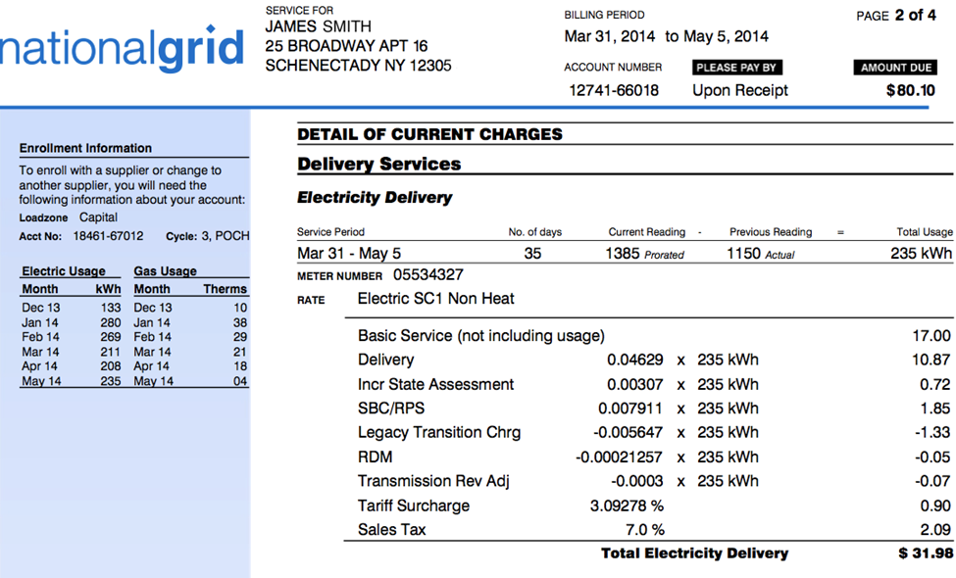
Example of Two-Part Tariff in Electricity Bill
FIXED FEE
USAGE FEES
TAXES

Slide 25
Two-Part Tariffs in Utility Industries
Price/unit
Two-part tariff:
Usage charge P_{U} = MC
Fixed charge = [AC(Qu)-MC(Qu)] * Qu
Demand
AC
AC(Q_{U})
FIXED CHARGE
P_{U}
MC
Q_{U}
Output/hr
0

Slide 26
Part E: Non-Price Strategies
Tie-Ins
© Anna P. Della Valle

Slide 27
Tie - Ins
When purchase of a product/service is tied
to the purchase of another product/service

Slide 28

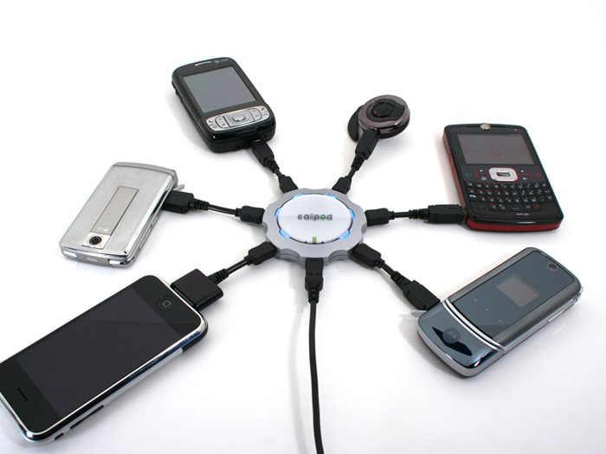
Examples
Shoes and laces
Printers and ink cartridges
Phone and charger
PC operating system (Office) and peripherals (web browser, graphic package, visual/audio player)

Slide 29
Rationales for Tie-Ins
Convenience
Efficiency
Assure quality
Gain/expand market power
Increase sales/profits
Evade price controls/regulations
Cross subsidize

